Slide 1

13. DICTIONARY

Slide 2
SESSION OVERVIEW:
DEFINITION
CREATION
CHANGE
REMOVE
COMPREHENSION
METHODS & BUILT-IN FUNCTIONS
OPERATIONS

Slide 3
DEFINITION
Dictionary in Python is an ordered collection of data values,
used to store data values like a map, which, unlike other Data Types that hold only a single value as an element,
Dictionary holds key:value pair.
Key-value is provided in the dictionary to make it more optimized.
As of Python version 3.7, dictionaries are ordered. In Python 3.6 and earlier, dictionaries are unordered.

Slide 4
CREATION
In Python, a Dictionary can be created by placing a sequence of elements within curly {} braces, separated by ‘comma’.
Dictionary holds a pair of values, one being the Key and the other corresponding pair element being its Key:value.
Values in a dictionary can be of any datatype and can be duplicated,
whereas keys can’t be repeated and must be immutable.
Dictionary keys are case sensitive
Dictionary can also be created by the built-in function dict().
An empty dictionary can be created by just placing to curly braces{}.

Slide 5
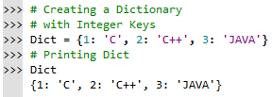



Slide 6
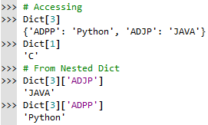
ACCESSING
In order to access the items of a dictionary refer to its key name.
Key can be used inside square brackets.

Slide 7
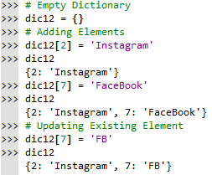
ADDING ELEMENTS
Dict[Key] = ‘Value’
While adding a value,
if the key value already exists, the value gets updated
otherwise a new Key with the value is added to the Dictionary.

Slide 8
DELETION
In Python Dictionary, deletion of keys can be done by using the del keyword.
specific values from a dictionary , Items in a Nested dictionary as well as whole dictionary can be deleted.
del Dict will delete the entire dictionary and hence printing it after deletion will raise an Error.

Slide 9
DICTIONARY METHODS
copy() They copy() method returns a shallow copy of the dictionary.
clear() The clear() method removes all items from the dictionary.
pop() Removes and returns an element from a dictionary having the given key.
popitem() Removes the arbitrary key-value pair from the dictionary & returns it as tuple.
get() It is a conventional method to access a value for a key.
update() Adds dictionary dict2’s key-values pairs to dict
setdefault() Set dict[key]=default if key is not already in dict
keys() Returns list of dictionary dict’s keys
items() Returns a list of dict’s (key, value) tuple pairs
has_key() Returns true if key in dictionary dict, false otherwise
fromkeys() Create a new dictionary with keys from seq and values set to value.
cmp() Compares elements of both dict.

Slide 10

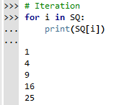
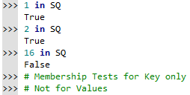
DICT OPERATIONS
Iteration
Membership Test

Slide 11

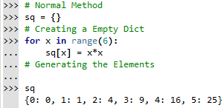
COMPREHENSION

Slide 12
Python Collections
There are four collection data types in the Python programming language:
List is a collection which is ordered and changeable. Allows duplicate members.
Tuple is a collection which is ordered and unchangeable. Allows duplicate members.
Set is a collection which is unordered and unindexed. No duplicate members.
Dictionary is a collection which is ordered and changeable. No duplicate members.

Slide 13
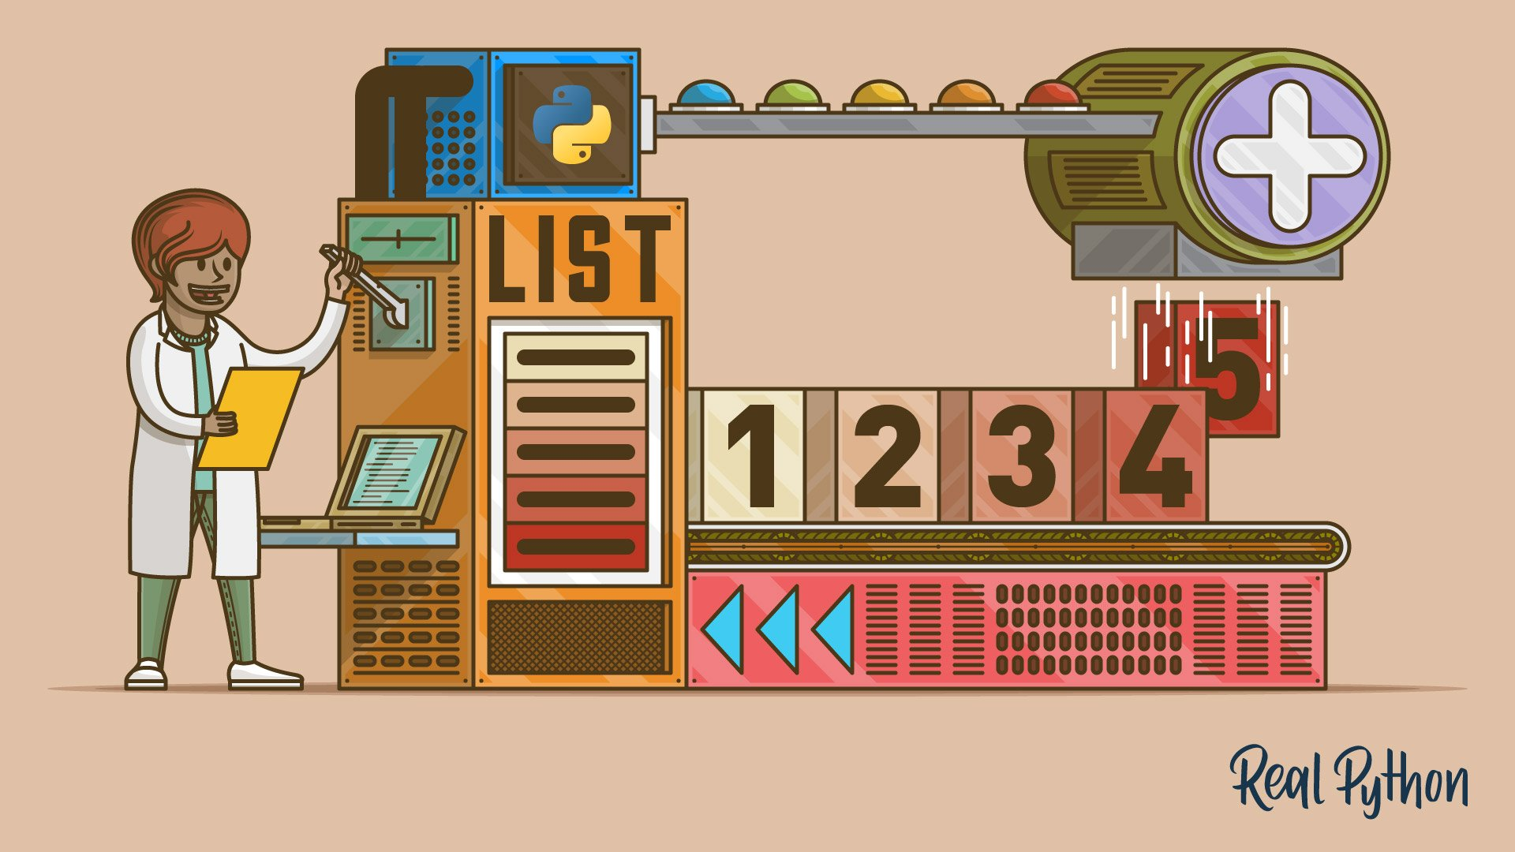
CODING IS FUN ! THANK YOU !!

